Slide 1
VISUAL C#.NET session 17
Instructor: Edwin oduor

Slide 2

Quote of the day

Slide 3
Lesson objectives
Writing Queries
WHERE clause
SQL AND, Or, NOT
Order By
Update, Delete commands

Slide 4
Lesson pre-requisites
In order to take full advantage of this section you need to have the following;
Computer with Visual Studio Installed.
Stable Network Connection.

Slide 5
Training methods and extra readings
TRAINING METHODS FOR THIS LESSON
EXTRA READINGS
Lecturing Method – This is the main method of training to be adopted in this lesson with illustrations and practical coding examples.
Discussion Method - This method will be adopted periodically whereby learning will be derived principally from the students brainstorming together, rather than from the trainer. Three main types of discussions will be used:
Directed discussion
Developmental discussion
Problem-Solving discussion
Home and Learn C#

Slide 6
Writing queries

Slide 7
Select query

Slide 8

Select Query – select is used to query the database i.e. to display some data from the table.
For instance, if one wants to display all the records in a table then, the query should look like this,
From the above code all the data and fields are being displayed, the asterisk represents all fields in the table, MakePurchase is the name of the table.

Slide 9
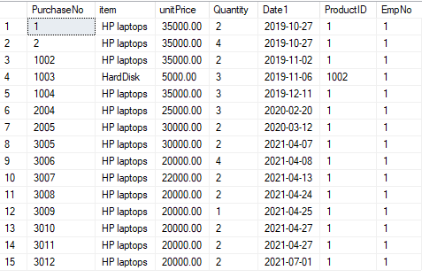
The out-put is as follows.

Slide 10
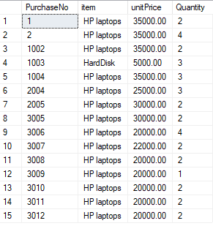
Suppose now we want to display some specific fields from the table. Then the query is going to look like this.
The out-put will give us this.

Slide 11
Where clause

Slide 12

WHERE Clause used to filter out records in the table based on what the user wants.
Suppose now we want to display sales that were made whose unitPrice is greater than or equals to 35000, then the where clause will be introduced in the query.

Slide 13

Using where clause with like
In The code below when using like with where it’s going to filter out data, in this case it’s filtering data based on last name where the last name is starting with K

Slide 14
Using and in a query
The AND operator is used to combine two cases for instance in the code below, checking for employees whose Last name is starting with K and also the Gender should be Male.

Slide 15

Using or in a query
Checks for both conditions and returns the conditions if they are true, as shown in the table below.

Slide 16

Using not in a query
Going to give the output of all employees apart from the employee whose name is included in the not.

Slide 17
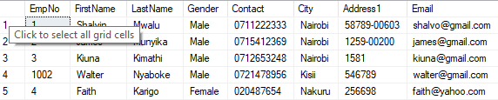
Order by
Used to arrange the output of the query, one can opt to arrange the output using a specifies field in either Descending or Ascending order.

Slide 18
Update query
The update is used to update an existing data i.e., if one has realized that there some mistake with the data entered then an update query will be able to make changes to the table.
The last name of the employee who has Emp No 1 is going to be updated to Mwalu from what was there initially.

Slide 19
Delete query
The delete query is used to permanently remove an item in the table.
From the above code we are using the Emp No to delete the employee from the table.

